Slide 1
Mental health in small business
Notes:
Hello everyone, and welcome to this presentation on mental health in small business. My name is [insert name] and I will be taking you through this presentation today.

Slide 2
Contents
What is mental health?
Challenges faced by small business owners
The Ahead for Business digital hub
Notes:
In this presentation we are going to cover…

Slide 3
What is mental health?
Mental health is emotional, psychological, and social wellbeing. It helps us to:
Cope with daily stress
Build resilience for adverse events
Participate in and enjoy life
Mental ill-health is any mental health problem experienced
e.g. thoughts and feelings that interrupt normal functioning
Notes:
To start, we’re quickly going to talk about what mental health is. When people think of mental health, they often think of having a mental illness such as depression, anxiety, and substance abuse. BUT mental health, or being mentally healthy is more than just the absence of illness, it’s more like a state of wellbeing.
It’s about having a sense of emotional, psychological, and social wellbeing and the ability to cope with the normal daily stresses or adverse events, and to actively participate in and enjoy life.
As a small business owner this means feeling mentally equipped to cope with the stress of running a business, and being able to face unexpected challenges without experiencing emotional problems.
Mental ill-health on the other hand refers to any mental health problems or mental illnesses someone might be experiencing. These issues can impact day-to-day activities and decrease the quality of life. For example, your thoughts and feelings can prevent you from running your business to the best of your ability.

Slide 4
Your mental health
Poor mental health
Stressful personal and business events make the temperature of the thermometer rise
Doing things that contribute to good mental health (e.g. self-care) help lower the temperature
Lower temperature = better mental health
Visit aheadforbusiness.org.au for more information
Good mental health
Notes:
To put this in more of a small business context – imagine your mental health like a thermometer. When the temperature is low you are feeling mentally healthy and ready to face the daily challenges of running a business.
As stressful events start to add up in both your personal and business life, for example forgetting to put an order in, having a deadline moved forward, or losing an employee – the temperature of the thermometer starts to rise [click].
It’s normal to be juggling a few stressful events at a time, and most of us can manage a moderate temperature while maintaining good mental health. However, if lots of small stressors start building on top of this, or one large stressor such as COVID-19 occurs, the temperature will keep rising and have a negative impact on your mental health [click].
As a small business owner, it’s therefore important to be proactive about your mental health and do things to cool the temperature of your thermometer and ensure you’re up to facing the daily challenges of running a business [click].
This includes engaging in self care practices and making changes to your workplace to help make it more mentally healthy. You can find out more about how to do this on the Ahead for Business digital hub.

Slide 5
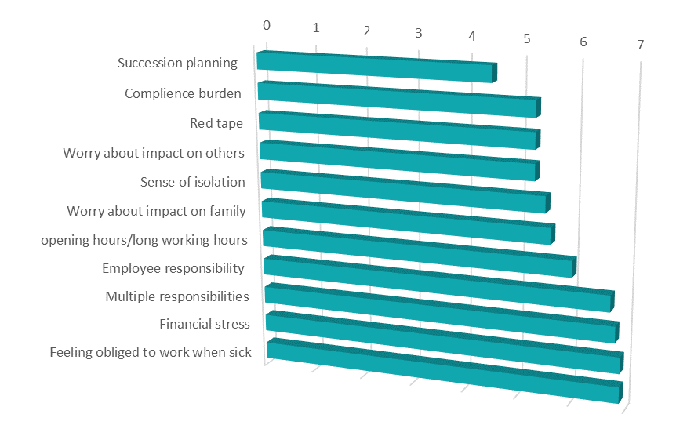
Business stressors for small business owners (2017)
Notes:
I’ve mentioned that running a business comes with challenges, and while each business faces its own unique challenges, there are many common ones too.
Let’s take a quick look at some national data that gives us an idea of the main challenges and stressors small business owners in Australia are facing, these might be some things that contribute to the rising temperature in your thermometer.
In 2017 Everymind conducted a survey and in depth interviews with small business owners across Australia to find out their biggest business stressors.
The stressors that were most prevalent were: feeling obliged to work when sick, dealing with financial stress, having multiple responsibilities, as well as responsibility for employees, and working long hours.
While these stressors are still relevant today, with the impact of COVID-19, these have changed.

Slide 6
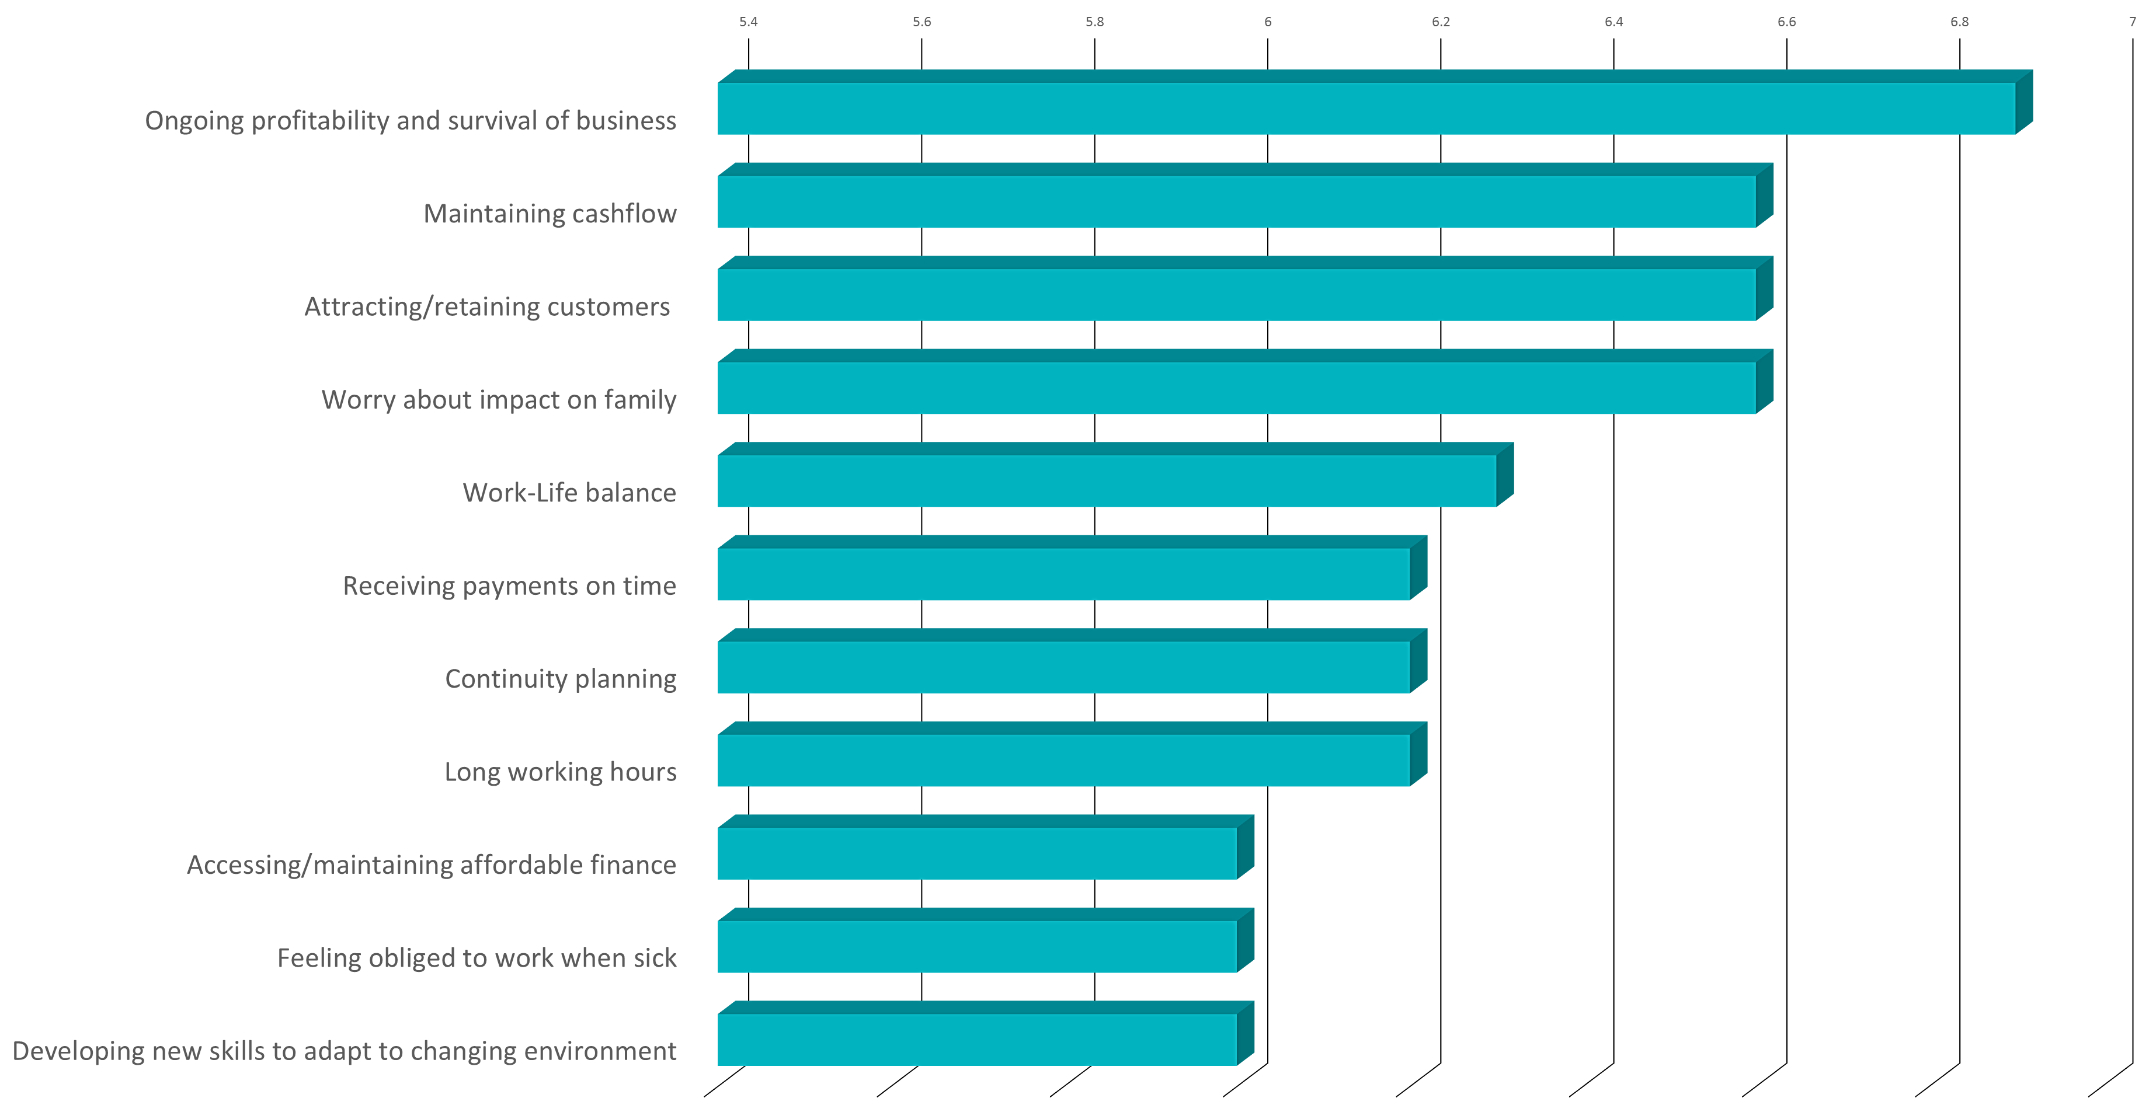
Business stressors for small business owners (2020)
Notes:
More recent research, conduced by the department of Industry, Science, Energy and Resources in 2020 shows a slight shift in business stressors.
Currently, small business owners are worried about the ongoing profitability or survival of their business, followed by maintaining cash flow, attracting and retaining customers, and worry about the impact on their family. As a small business owner, you can probably relate to a few of these.
As the impact of COVID starts to ease, we may see these stressors shift yet again, as the small business environment changes, so too will the challenges and stressors that come with it.
It’s also worth noting that this research found that those showing the greatest concern for their mental health were more likely to be female, in the younger age group of 18-39, and in the start-up and pre-profit stage of their business. Business owners in one or more of these categories should therefore pay close attention to improving their mental health and wellbeing.

Slide 7
Percentage of small business owners reporting symptoms of depression/anxiety
Notes:
With all these challenges and stressors in mind, it’s easy to see how owning and running a business can build up the temperature in your mental health thermometer and lead to symptoms of stress, anxiety, or depression. In fact, research by Everymind found small business owners reported symptoms of depression 18% more frequently and symptoms of anxiety 23% more frequently than the general population. These included symptoms ranging from mild to extremely severe.
These higher rates of mental ill-health highlight the need for small business owners to prioritise their mental health. This means that those experiencing symptoms of mental ill-health should seek help, and take the actions to improve their mental health. It also means those in good mental health need to take action to maintain this. We never know when challenges or adversities will come our way, so keeping the temperature of our thermometer as low as possible will help you cope when they do.

Slide 8
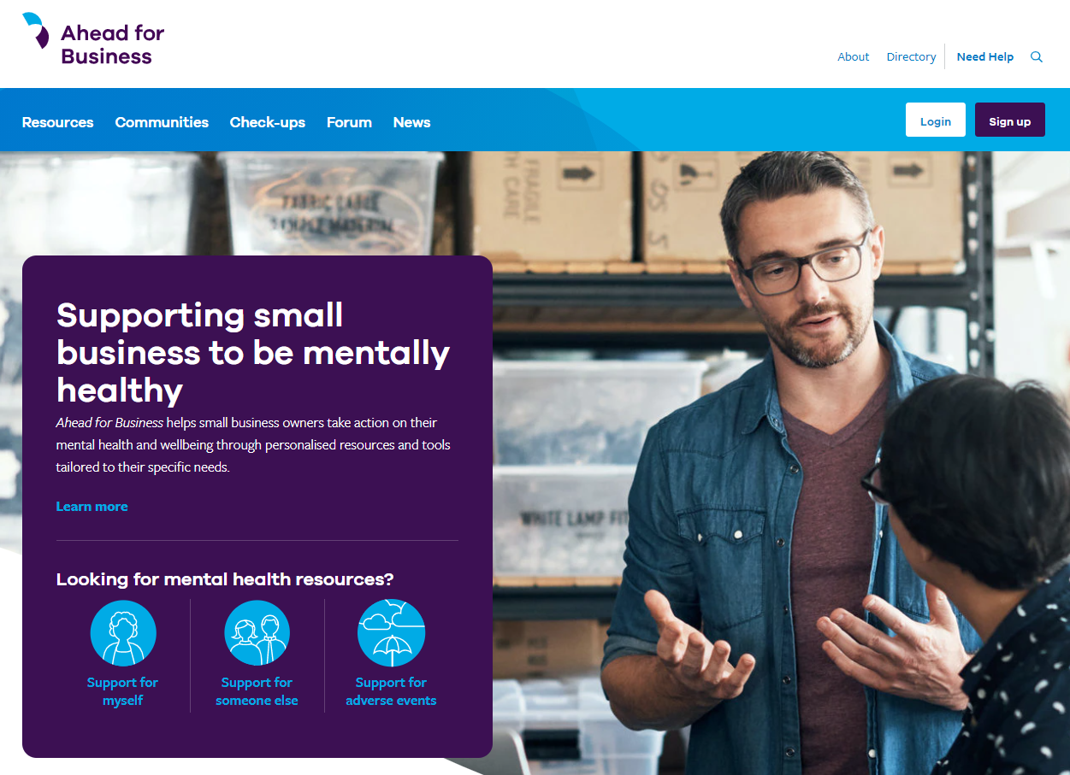
Digital hub
A variety of resources to help support the mental health of small business owners:
Tailored information and resources
Social forum
Business stressor screen
Online wellbeing plan
Mental health check-up
Personal small business portal
Notes:
A great place to find information, tools, and resources to help support your mental health as a small business owner is the Ahead for Business digital hub. The content on the website is designed to help you be proactive about your mental health so you are better equipped to face the emotional challenges that come with running a business. Over the next few slides I will highlight some of the features that may be helpful to you.

Slide 9
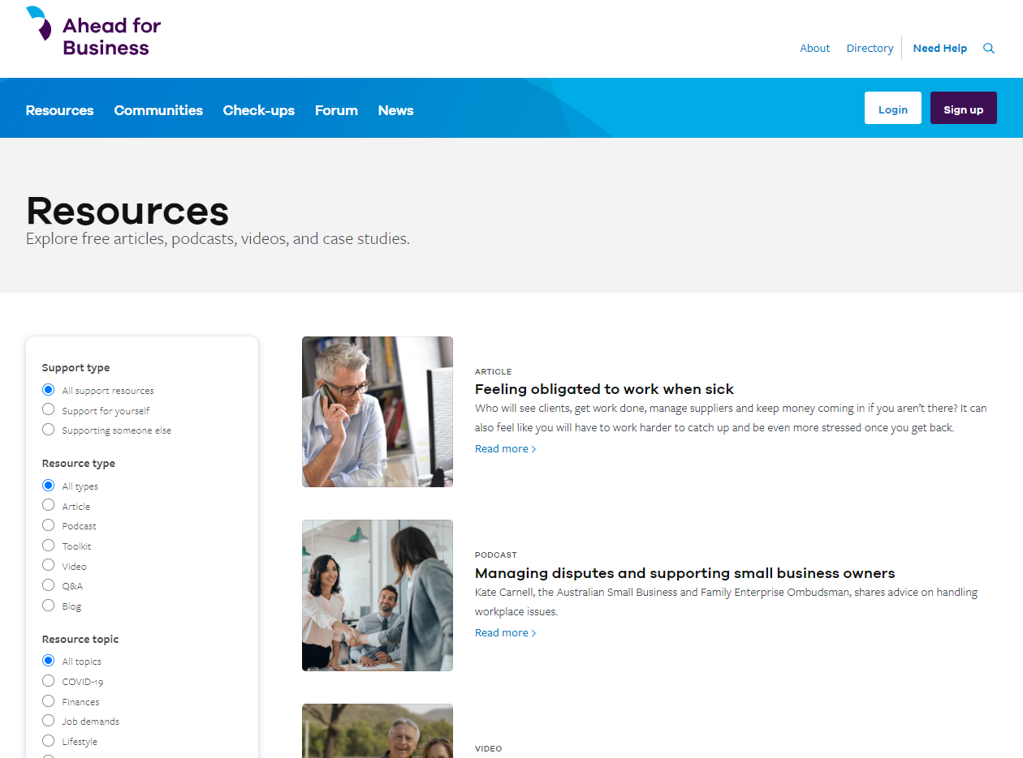
Resources
Articles
Videos
Podcasts
Toolkits
Blogs
Q&As
Notes:
Firstly I will touch on the wealth of written articles, videos, case studies, podcasts, toolkits and real-life stories that are available on the Ahead for Business digital hub. You can find resources that help support yourself, or resources to help you support someone else who may be struggling.
If you are looking for something in particular you can use the search function, or filter by topics or resource types that you are interested in. Whatever you are looking for, you are sure to find some relevant information at aheadforbusiness.org.au.
Earlier I touched on the importance of self care in keeping your mental health in check – you can find a variety of different resources on this topic by typing it into the search bar, take a look for yourself after this presentation.
Many of the resources are also created in collaboration with other organisations. For example, Ahead for Business co-designed a series of toolkits with the Department of Industry to help business owners identify and utilise their existing support networks, and worked with the National Mental Health Commission to create guides on how to create a mentally healthy workplace during COVID-19. These collaborations ensure you are getting the best information possible.

Slide 10
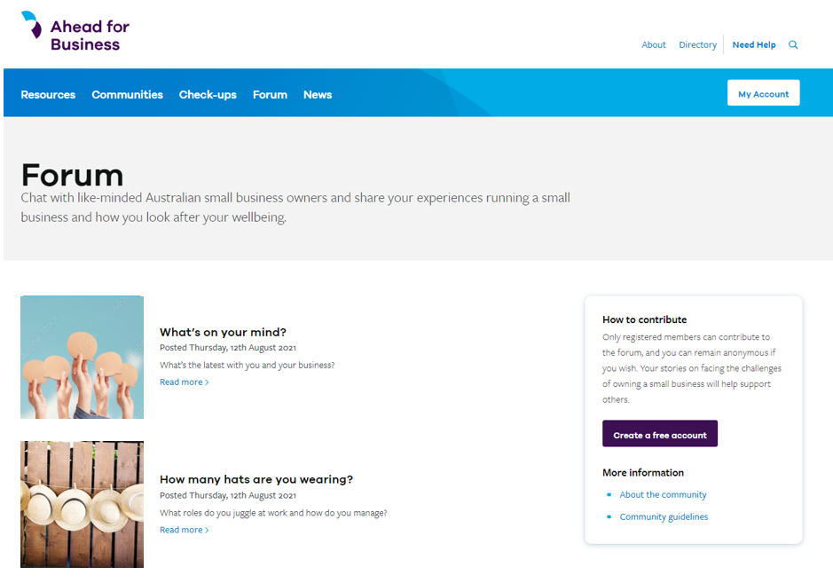
Social forum
Connect with like minded small business owners to share your own experience, challenges, and tips on how you manage your mental health and wellbeing while running a business.
Notes:
I will also touch on the Ahead for Business social forum. This anonymous peer-to-peer forum allows you to share your challenges, experiences and tips with other small business owners who may be going through something similar.
Social support is really important to mental health, so sharing your thoughts with like minded small business owners is a great way to look after your wellbeing. I recommend you take a look after this presentation.

Slide 11
Business stress test
An interactive tool that assists small business owners to identify personal stress points and connects them to resources to support the management of these stressors.
Notes:
Next I’m going to overview the three interactive tools you can use as part of the Ahead for Business website. They are all completely free, they just require you to have an account.
The business stressor screen is a 2-minute interactive tool that lets you identify how you are managing common business stressors. After completion you will get personalised recommendations and resources based on responses.
As can be seen on the screen, this person indicated that not having enough time to do anything was a stressful issue, and has been recommended resources on work-life balance and peer support.
Once completed, small business owners can check their progress, save results and track improvements over time.

Slide 12
Mental health check-up
An online mental health check-up which helps small business owners to understand their current mental health and wellbeing status and steps for action.
Notes:
Another feature is the mental health check-up, which is a tool that helps small business owners to understand their current mental health and wellbeing status.
The check-up includes questions around depression, anxiety, stress, alcohol use, and wellbeing.
Once answered, areas for action will be identified and personalised results and recommendations are provided. Results for this can also be tracked over time.

Slide 13
Wellbeing plan
A live, digital document which can be tailored and updated by small business owners to support them to take action on their mental health and wellbeing.
Notes:
Finally, the wellbeing plan. This is a live, digital document that can be tailored and updated by small business owners to support them to take action on their mental health and wellbeing.
It allows small business owners to:
- Discover what fills your ‘feel good’ bucket whilst at work.
- Understand the things that might put holes in their bucket, and how to take action to address these stressors.
- Develop a realistic plan for their own mental health and wellbeing, tailored to the needs of small business.

Slide 14
Summary
Small business owners face many unique challenges that can impact mental health.
It’s important to be proactive about your mental health to ensure you can cope with the stressors of running your business.
The Ahead for Business digital hub has many resources to help you be more proactive about your mental health.
Visit aheadforbusiness.org.au for more information.
Notes:
We have reached the end of this presentation on mental health in small business.
We have discussed that small business owners face many unique challenges and stressors while running their business that can make them more susceptible to symptoms of mental illness such as depression, anxiety, and stress.
It’s important to be proactive about you mental health to help you build resilience for when stressful events happen to you. The Ahead for Business digital hub is a great place to find tools and resources to help you with this.
Visit aheadforbusiness.org.au. Thank you.

